Slide 1
Introduction to the course: Verifying cyberphysical systems
Verifying cyberphysical systems
August 29th 2019
Sayan Mitra
mitras@illinois.edu

Slide 2
Welcome

Slide 3
Introduction
What is this class about?

Slide 4
The verification problem
System Model/Code & Property
Algorithm
or Method
Bug trace
Certificate
Verification. The action of demonstrating or proving to be true by means of evidence; formal assertion of truth. (OED)

Slide 5
An example
System. A subroutine sort(int a[])
for returning a sorted array of integers in some programming language, e.g. C
counterexample. A particular input array a and initialization of sort that produces wrong output
A model M for execution of programs in C
System Model/Code & Property
Algorithm
or Method
Bug trace
Requirement. Output of sort(int a[])
is the sorted version of the input array a[]
Certificate
A mathematical proof that establishes that sort(int a[])works for all inputs in the given model M of C
Verifying compiler. Checks that sort meets the requirement

Slide 6
An cyberphysical example
System. A program/system for lane keeping control for vehicles
counterexample. A particular environment situation (lane geometry, sensor failure, computer configuration) that makes the vehicle go outside lanes
Model/assumptions for executing such programs including the effects on the physical vehicle
System Model/Code & Property
Algorithm
or Method
Bug trace
Requirement. The vehicle does not go outside the lane boundaries
Certificate
A mathematical proof that establishes that for all allowed inputs and environments the vehicle stays with the lane
Verification tool

Slide 7
Verifying cyberphysical system
Cyberphysical system (CPS): a computer controlling something physical. For example, car, drone, medical device, power grid, etc.
The number of possible behaviors* usually uncountably infinite
Requirement: Assertions about all behaviors
Under all nominal conditions the vehicle stays within the lanes
Under all nominal driving conditions the emissions are within the prescribed range
The drone visits the waypoints while avoiding collisions
Insulin pump maintains blood glucose level to within the prescribed range
Testing: evaluates requirements on a finite number of behaviors
Verification: aims to prove requirements over all behaviors
* To be defined precisely

Slide 8
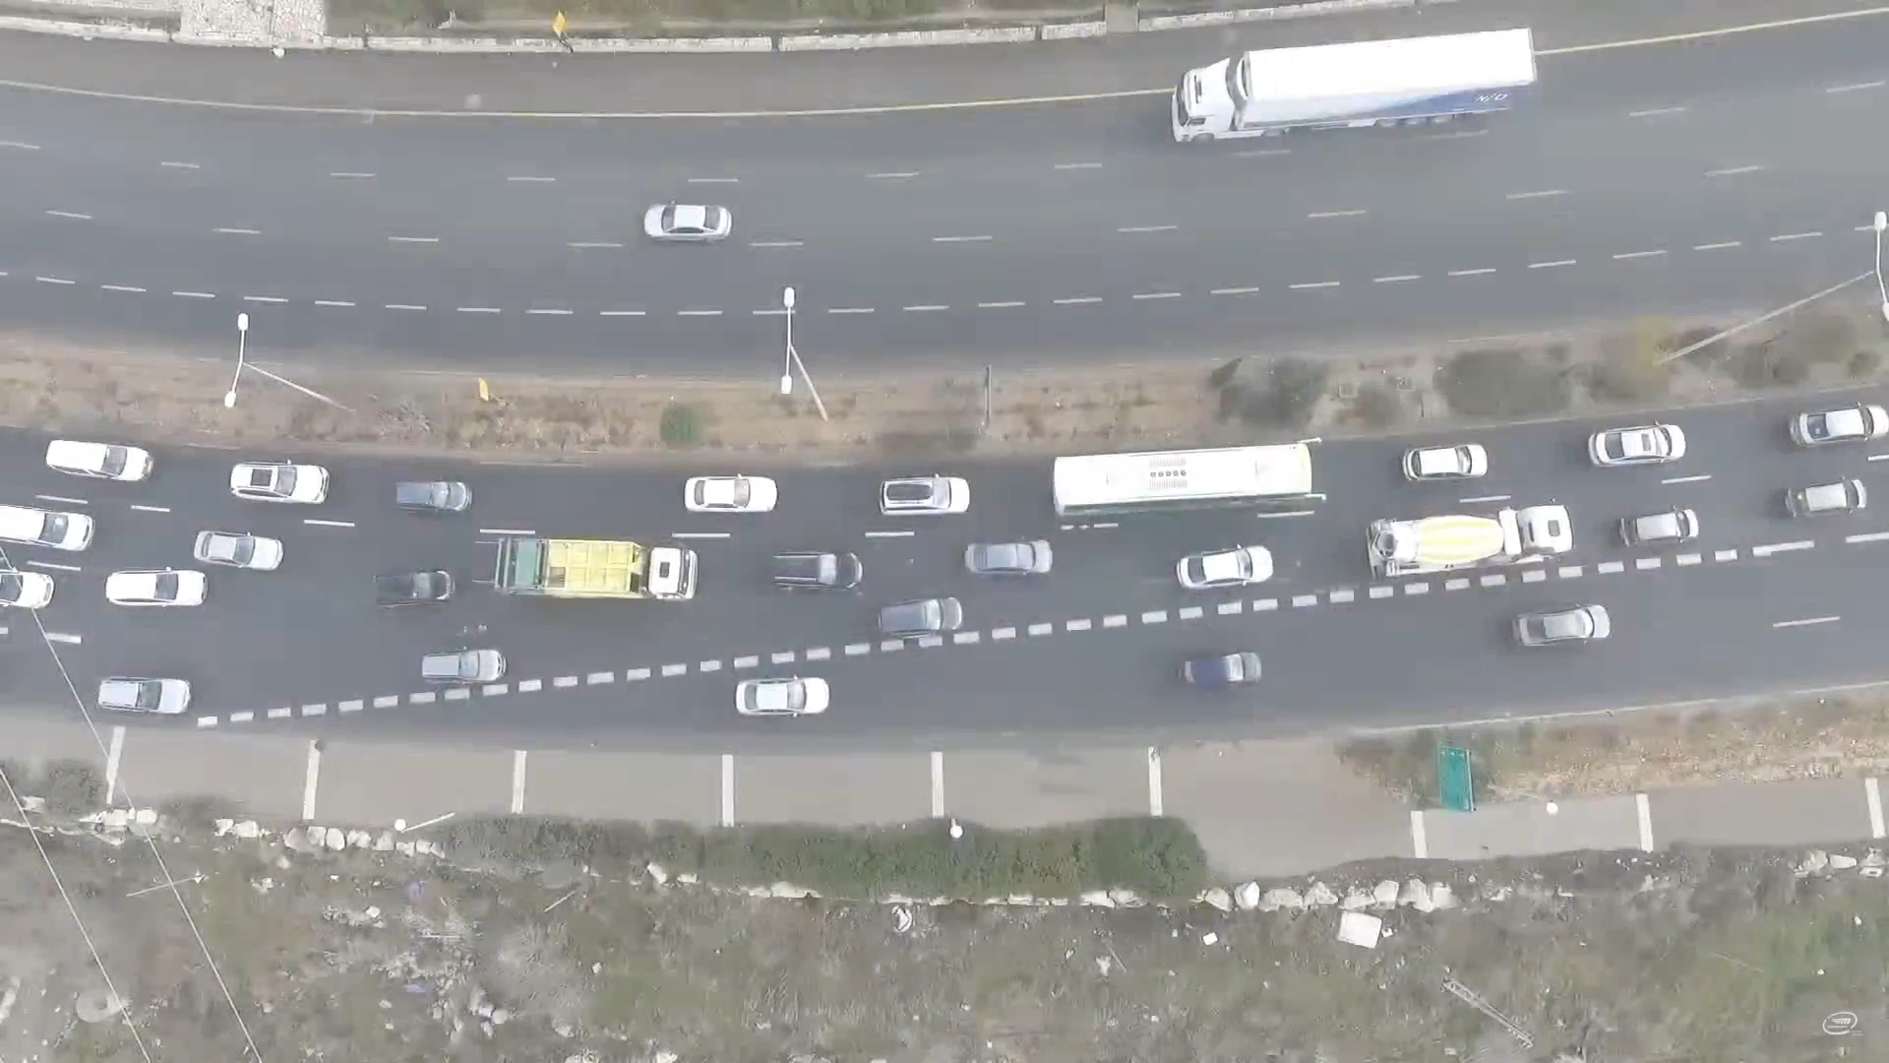
video from talk by Amnon Shashua
Notes:
Decision making is hard… see how this car has to make many many decisions over the next 5 seconds and then giveup on the merge.

Slide 9
Suppose car has 2 choices every 10ms, how many positions could it be in in 10 seconds? Predicting all futures
2¹²⁰> the number of atoms in the visible universe
time = 0
states = 1
t = 10
S = 2
t = 20
S = 4
t = 30
S = 8
t = k
S = 2^{k/10}
Notes:
Hamlet’s car: To overtake or not to overtake
Unlike the prince of Denmark

Slide 10

State space explosion! Number of states grow exponentially with time!
2²⁴⁰
S=2^{k/10}
2¹²⁰
time = 0
states = 1
t = 10
S = 2
t = 20
S = 4
t = 30
S = 8
t = k
S = 2^{k/10}
t = 1.2
Notes:
6-12: 10 minutes
Compound interest is an example of exponential growth.
This problem of fickle drivers is rearing its head.

Slide 11
How many miles must an autonomous car test drive before we call it safe?
200 million miles?
0.07 fatalities per billion passenger miles (commercial flight)

Slide 12
Why is air-travel so safe?

Slide 13
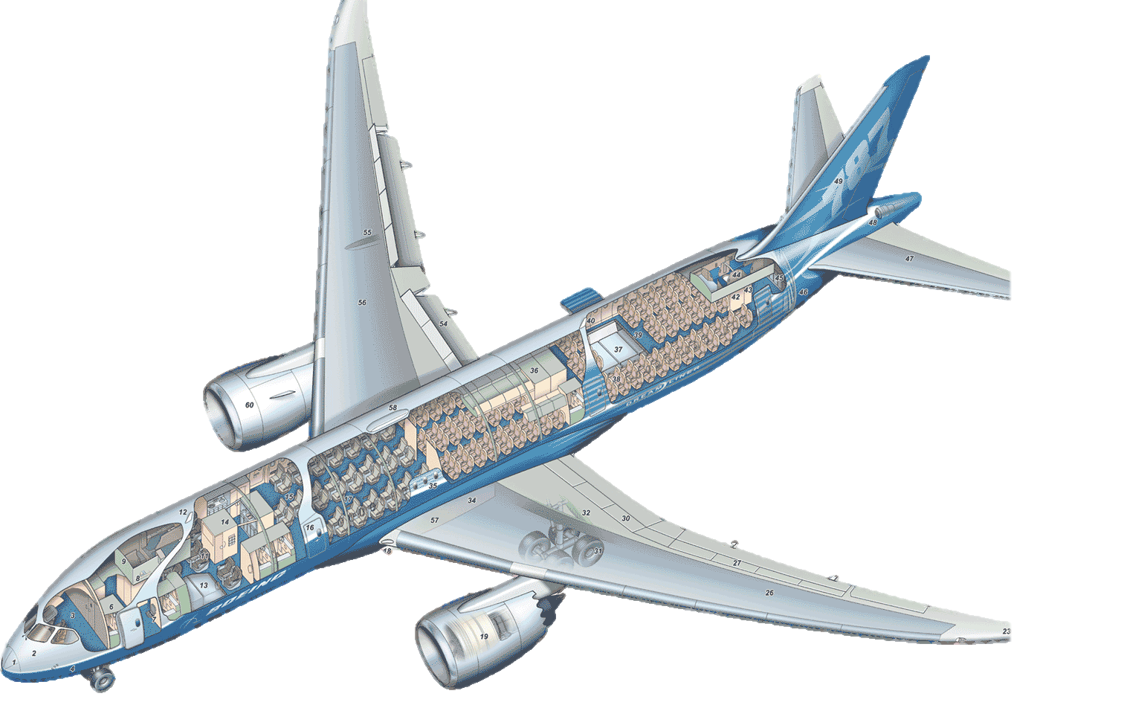

Regulations and Audits
What fraction of the cost of developing a new aircraft is in SW?
How much does it cost to change 1 line of code?
DO178C
Primary document by which FAA & EASA approves software-based aerospace systems.
DAL establishes the process necessary to demonstrate compliance
Supplement DO-333 supplement of DO-178C identifies aspects of airworthiness certification that pertains to of software using formal methods
Dev.Assurance Level (DAL) | Hazard Classification | Objectives
A | Catastrophic | 71
B | Hazardous | 69
C | Major | 62
D | Minor | 26
E | No Effect | 0
Statement Coverage: Every statement of the source code must be covered by a test case
Condition Coverage: Every condition within a branch statement must be covered by a test case
Notes:
It costs 1-10 million dollars to change a single line of code
Today I will talk about verification of safety critical AE system of which the modern commercial airliner is probably the grandest example of.
Outset, we have to say that these air travel by a commercial airline is extremely safe by about every measure.
6” of leg space in an exit row is in high demand because the probability of being in a flight where the extra responsibility of being in an exit row would matter is very low.
The invisible hand that has made the safety record so impressive are the regulations that the US govt (and its European counterpart) puts in place for any airline to operate in the US airports.
From the phrasing of the safety announcements, to the weight of the cockpit door to # on board defibrillators, the FAA regulates no only the flying equipment but also the processes in the airports in countires from which the plane take off.
Part of this regularoy process that is relevant for my research is this document called DO178C by which FAA and EASA approve airbourne software
Categorizes into Levels
E.g., any software that commands, controls, and monitors safety-critical functions should receive the highest DAL - Level A.
Catastrophic - Failure may cause multiple fatalities, usually with loss of the airplane.
Hazardous - Failure has a large negative impact on safety or performance, or reduces the ability of the crew to operate the aircraft due to physical distress or a higher workload, or causes serious or fatal injuries among the passengers.
Major - Failure significantly reduces the safety margin or significantly increases crew workload. May result in passenger discomfort (or even minor injuries).
Minor - Failure slightly reduces the safety margin or slightly increases crew workload. Examples might include causing passenger inconvenience or a routine flight plan change.
No Effect - Failure has no impact on safety, aircraft operation, or crew workload.
The Airbus A320 jetliner, for example, a major product of the DO-178B era, contains a total of 800,000 lines of code in all of its avionics systems, points out Nat Hillary, field applications engineer with LDRA Software Technology, a software tool supplier in San Bruno Calif. By contrast the Boeing 777, a newer aircraft, features around 4 million lines of code.

Slide 14
Verification aims to mathematically prove requirements over all behaviors
To prove anything, first we have to start with assumptions
These assumptions will be captures in the models of cyberphysical systems
“All models are wrong, some are useful”
1/3 of this class is about models
Programs, state machines, or differential equations, block diagrams?
Discrete or continuous time
Discrete or continuous state or both
Hybrid, switched
Deterministic or nondeterministic or both or neither
Composition and interfaces
Abstraction
Modeling languages, tools

Slide 15

Verifying hybrid models is a very hard problem
Verification of hybrid automaton is undecidable
No one can find the is Algorithm of that type
Approximate and bounded time versions of the problem can be solved algorithmically, but often the algorithms do not scale with the size of the model, number of agents, time horizon, etc.
Models are often hard to get
IP protection
Too complex, messy
Machine learning modules
System Model/Code & Property
Algorithm
or Method
Bug trace
Certificate
Notes:
buzzkills, hype-kills

Slide 16
Silver linings (course objectives)
Invariant, barrier certificates, ranking functions, stability, self-stabilization, convergence, transition system
Learn the foundational connections between computer science and control theory
Model everything
Introduction to key concepts in formal methods and cyberphysical systems; exposure to some of the most influential ideas in CS and
Learn powerful algorithms and tools
Jumpstart research
Programs, state machines, or differential equations, discrete or continuous state or both, Hybrid, switched, Deterministic or nondeterministic or both, composition, interfaces, abstraction, modeling languages, tools
satisfiability modulo theory, semantics, temporal logics, theorem provers, SAF solvers, ranking functions, data-driven verification, HYLAA, C2E2, SpaceEx, Flow*, Z3, …
semester-long project, feedback, presentation, hardware, software, and data resources

Slide 17
Beyond ECE/CS 584
Hardware verification (model checking) is now part of engineering practice in the industry
Automated Device Driver Verification at Microsoft: SLAM tool from MSR; AMAZON Web services verified using TLA
Formal modeling and analysis is becoming part of certification process for avionics (e.g., ASTREE); adoption for automotive and manufacturing around the corner
Commercial enterprises
Synopsis, Mentor Graphics, Cadence, Coverity, Galois, SRI, etc.
More up and coming in the automotive space
Vibrant research community:
Conferences: CAV, TACAS,HSCC, EMSoft
Faculty position openings
Related Turing Awards: Lamport (2014), Clarke, Sifakis & Emerson (2008), Pnueli (1997), Lampson (1992), Milner (1991), Hoare (1980), Dijkstra (1972) …

Slide 18
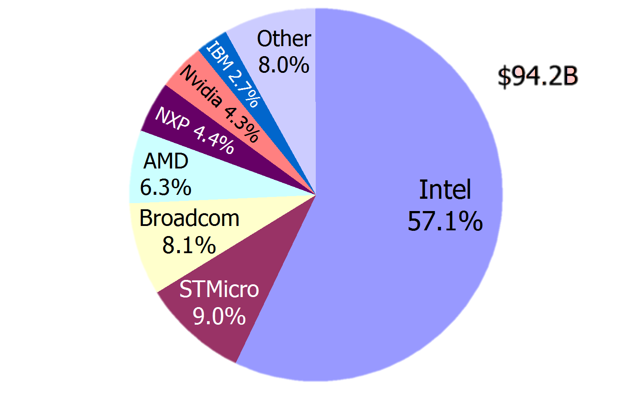
An earlier success instance: microprocessor industry and supporting design automation tools
Electronic design automation industry
Notes:
475m$ cost of replacing chips The Pentium FDIV bug was a computer bug that affected the floating point unit (FPU) of the early Intel Pentium processors. Because of the bug, the processor could return incorrect decimal results when dividing a number. Discovered in 1994 by Professor Thomas R. Nicely at Lynchburg College,^{[1]} Intel attributed the error to missing entries in the lookup table used by the floating-point division circuitry.^{[2]}

Slide 19
Administrivia

